Slide 1
Final Project Student Mental Health
Jonathan Steen
Bellevue University
DSC 530

Slide 2
DATA
The data was collected from Kaggle.
This dataset was collected by a survey conducted by Google forms from university students to examine their current academic situation and mental health.
https://www.kaggle.com/datasets/shariful07/student-mental-health

Slide 3
Data Variables
 | Variables | Meaning
Gender | 'Choose your gender' | Gender of student
Age | 'Age' | Age of student
CGPA | 'What is your CGPA?' | Cumulative grade point average of student
Depression | 'Do you have depression?' | Depression status of student
Anxiety | 'Do you have anxiety?' | Anxiety status of student
Treatment | 'Did you seek any specialist for a treatment?' | Treatment status of student
Year of Study | Year of Study | Student Classification

Slide 4
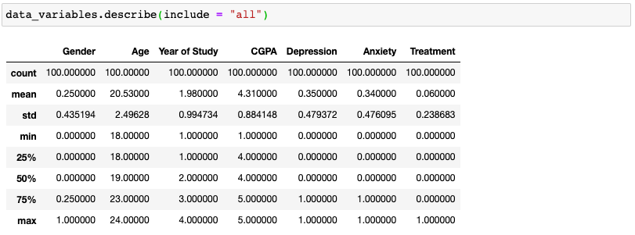
Variable Characteristics
Statistics - mean, deviation, quantiles and frequency for all the attributes

Slide 5
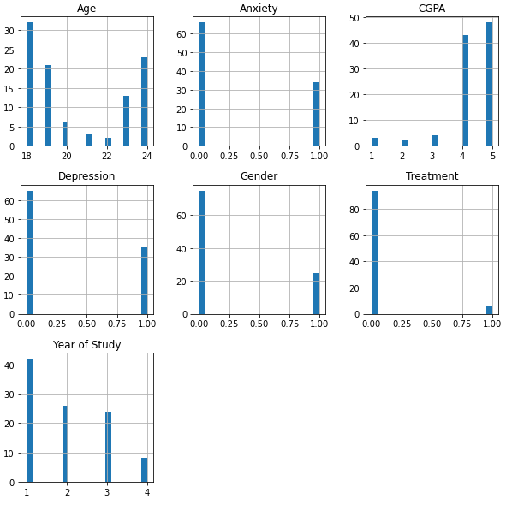
Histograms
Age distribution is relatively normal. The rest of my variables are categorial. None have noticeable outliers.

Slide 6
Outcome
Based on my EDA it is inconclusive if those who seek treatment will have a better CGPA than those who do seek treatment. I think more respondents and data are needed to really get an accurate picture.

